Slide 1
INITIAL RECRUITMENT TEST
(Junior Business Intelligence Analyst)
By Fajri Novitasari

Slide 2
Assume that we have the following table, named table “PEOPLE”. This table contain the following fields (note: the data is sample only):
FirstName | LastName | City | Weight | Gender | Province
John | Doe | Jakarta Barat | 70 | Male | DKI Jakarta
Please make a query to pull the following data:
a. List of provinces and the average weight of people in those provinces, only for provinces which average weight of people < 70
b. List top 5 people having the highest weight from each combination of province, city and gender

Slide 3
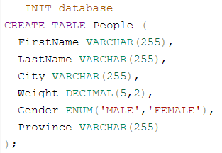
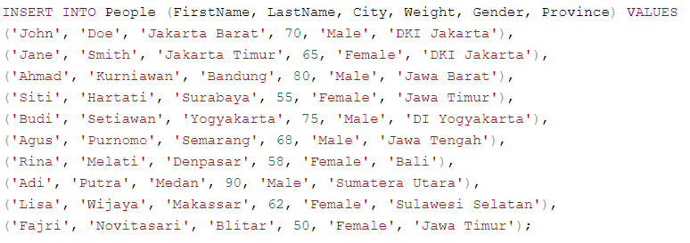
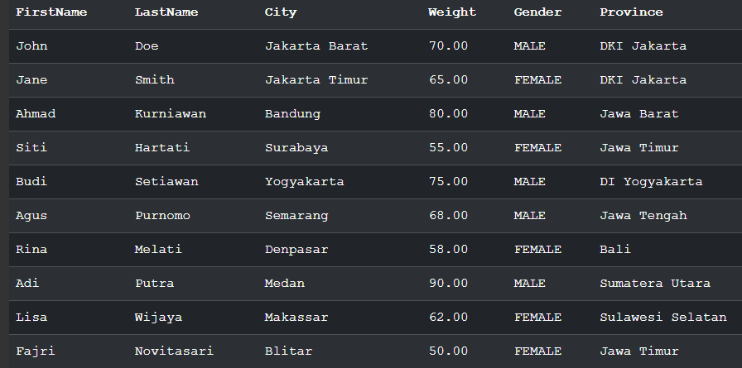
https://sqlfiddle.com/mysql/online-compiler?id=590dcd18-d511-44b3-b28a-4eb84d7cfc0b

Slide 4
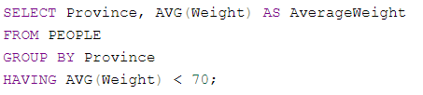
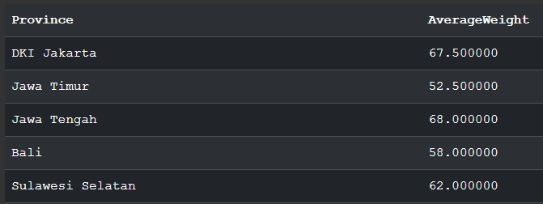
The SQL query calculates the average weight of individuals in each province from the PEOPLE table
The AVG(Weight) function calculates the average weight, and the GROUP BY Province clause groups records by province.
The HAVING AVG(Weight) < 70 clause is a filter that only includes the groups (provinces) where the average weight is less than 70
https://sqlfiddle.com/mysql/online-compiler?id=590dcd18-d511-44b3-b28a-4eb84d7cfc0b

Slide 5
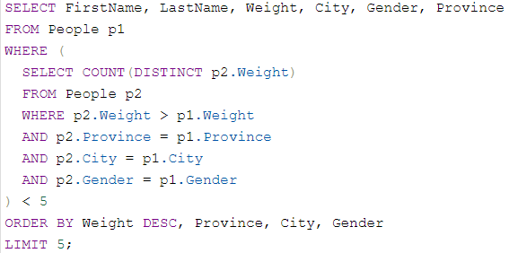
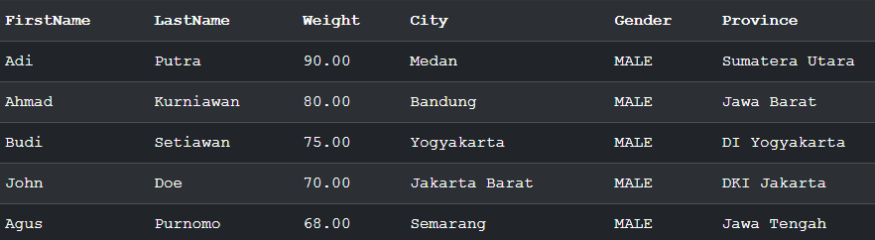
Select 5 heaviest people from each combination of province, city, and gender from the People table
https://sqlfiddle.com/mysql/online-compiler?id=590dcd18-d511-44b3-b28a-4eb84d7cfc0b

Slide 6
Describe Contained on Loan Contracts Table and Loan Contract Ledgers Table
Loan Contracts Table:
This table includes details about the loan contracts provided by lending institutions to borrowers. This includes the contract ID, contract creation date, contract status (e.g., active, completed, cancelled), loan duration (tenure), loan amount, loan terms (e.g., provisions, interest), and principal amount
Loan Contract Ledgers Table:
This table records all transactions related to the loan contract. This includes the ledger ID, associated contract ID, entry creation date, time period, ledger type, ledger status (e.g., paid, unpaid), opening balance, ending balance, due date, and payment date.

Slide 7
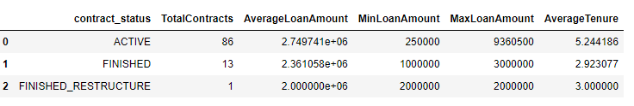
Describe Contained on Loan Contracts Table
The loan portfolio is 'ACTIVE' with a variety of loan amounts, indicating diverse financial products or borrower profiles.
'FINISHED' loans tend to be for smaller amounts and shorter durations, which might indicate successful repayment plans or smaller financial needs.
'FINISHED_RESTRUCTURE' of loans appears to be infrequent, with only one contract undergoing this process, suggesting that it may be a last resort or only offered under certain conditions.
AverageTenure tenure gives a sense of the loan terms, with active loans being longer-term than the finished loans, which could reflect the nature of the financial products offered or the borrowers' requirements.

Slide 8
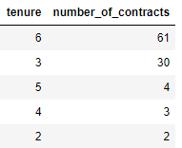

Describe Contained on Loan Contracts Table
Tenures 2, 4, and 5 are less frequent than the average, indicating they might be atypical in the context of the overall dataset.
Tenure 6 has the highest number of contracts, namely 61 contracts, which shows that it is the most common loan duration among others
The existence of 76 contracts with zero interest suggests that for these contracts, interest either has not been applied, or there are specific conditions or products that do not involve interest.
6 contracts with zero provision suggests that provisions are not universally applicable or necessary for all contracts and are only set aside in specific circumstances.

Slide 9
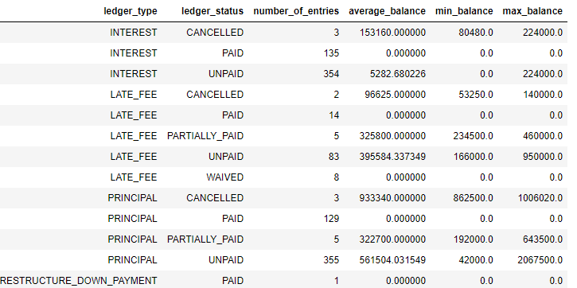
Describe Contained on Loan Contract Ledgers Table
There are a significant number of 'UNPAID' for 'INTEREST' and 'PRINCIPAL' entries, which could indicate liquidity problems or credit risks.
A single 'RESTRUCTURE_DOWN_PAYMENT' entry suggests loan modifications are rare.

Slide 10
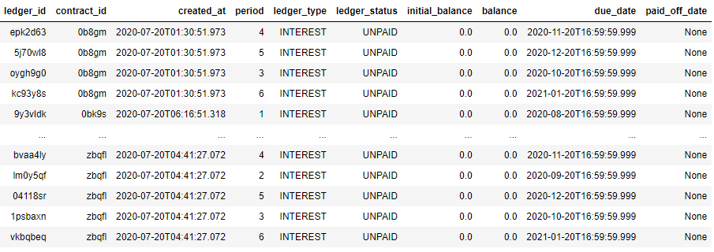
Describe Contained on Loan Contract Ledgers Table
All entries marked 'UNPAID' have zero balances, suggesting they may be future payments, not current debts.
a 'RESTRUCTURE_DOWN_PAYMENT' is marked 'PAID' with zero balance and no 'paid_off_date,' possibly indicating a loan restructuring that doesn't immediately affect the balance, or it may be a placeholder.

Slide 11
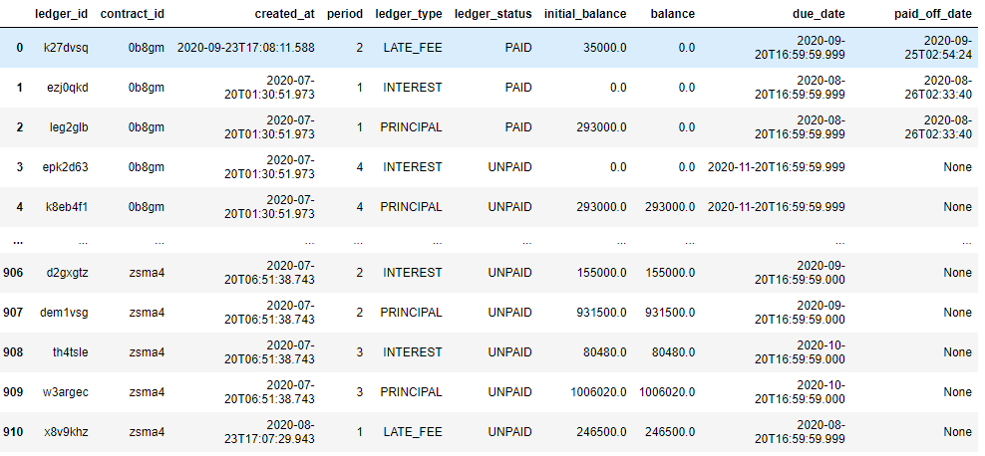
Describe Contained on Loan Contract Ledgers Table
'UNPAID' entries past due with balances suggest overdue payments and potential collection issues or borrower distress.
Entries with a 'PAID' status and a past paid_off_date confirm completed transactions, but the lack of paid_off_date for 'UNPAID' entries suggests these are still awaiting payment.

Slide 12
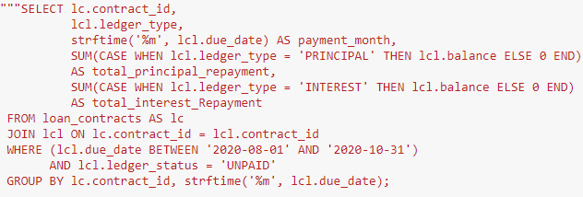
SQL code to produce the expected repayment amount from each principal & interest in the month of Aug, Sept & Oct
Calculate the total unpaid principal and interest payments for each contract during the period August to October 2020.
The SQL query uses SUM with a CASE statement to calculate two different totals for each contract_id and payment_month

Slide 13
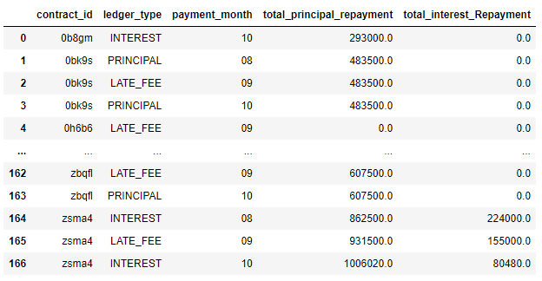
Result — SQL code to produce the expected repayment amount from each principal & interest in the month of Aug, Sept & Oct

Slide 14
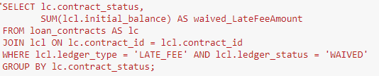

SQL code to display LateFee amount which has been waived for each contract status.
It calculates the sum of the initial_balance from the 'lcl' table but only for those ledger entries where ledger_type is 'LATE_FEE' and ledger_status is 'WAIVED'. Then groups the results by contract_status
The table shows that there are more late fees written off on active contracts compared to completed contracts

Slide 15
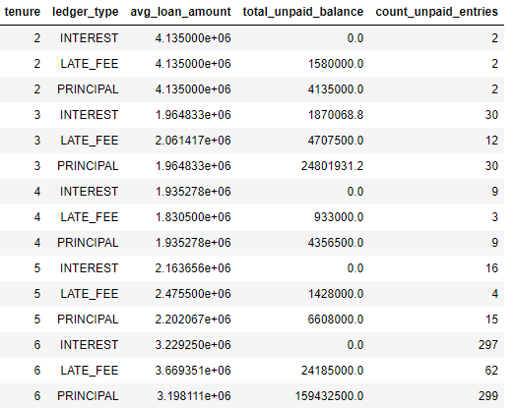
Analysis and Insight
Analysis of Potential Risk by Tenure and Amount
There is no outstanding interest balance, indicating all interest payments are on time or have been paid.
An unpaid late_fee balance indicates a problem paying fines in some periods.
Unpaid principal balances were recorded in all periods, with the highest amounts in periods 3 and 6.
Period 6 had the highest number of unpaid payment issues, indicating it was the most problematic.
The number of problems with principal payments occurs more frequently than problems with late payment of fines.

Slide 16
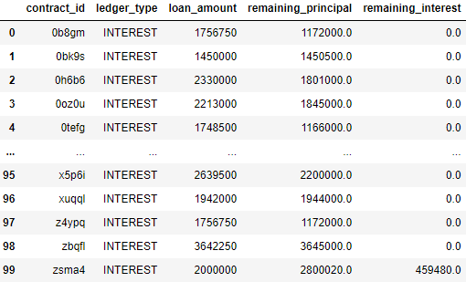
Analysis and Insight
Total Payment and Remaining Balance for Each Contract
For most contracts, there is no remaining unpaid interest (remaining_interest), indicating that the interest has been repaid in full.
However, there are some entries (as seen at the end of the first table) where the remaining unpaid interest (remaining_interest) is not zero, indicating that there is still interest that needs to be paid.
In some cases, the loan amount and remaining principal are the same, which may indicate that no payments have been made or that the loan was recently issued.

Slide 17
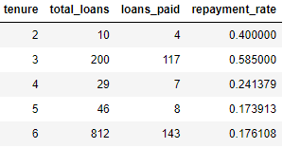
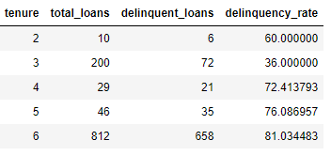
Analysis and Insight
Repayment Performance by Tenure
repayment_rate decrease with increasing tenure, with tenure 2 having the highest repayment_rate (40%) and tenure 6 having the lowest pay rate (17.61%).
delinquency_rate increases with increasing tenure, reaching a peak in tenure 6 with 81.03%.

Slide 18
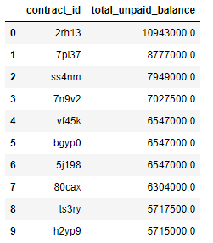
Analysis and Insight
Identifying Top Delinquent Accounts
shows the 10 contracts with the largest unpaid balances. The data has been sorted from highest to lowest unpaid balance, marking those contracts as the most important to pay attention to in terms of collection or credit recovery actions

Slide 19
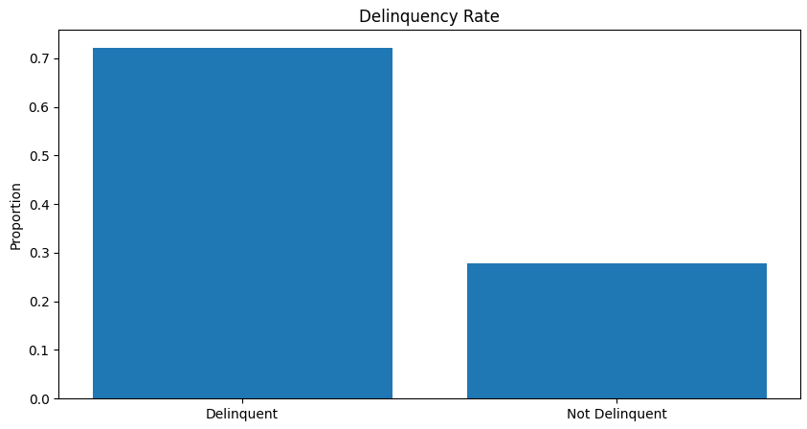
Analysis and Insight
Analysis of the level of late payments
The proportion for 'Delinquent' is significantly higher than for 'Not Delinquent', this indicates a high level of late payments in the loan portfolio. This could be an indicator of a problem in the credit granting process or perhaps in the economy as a whole that is affecting the borrower's repayment ability.

Slide 20
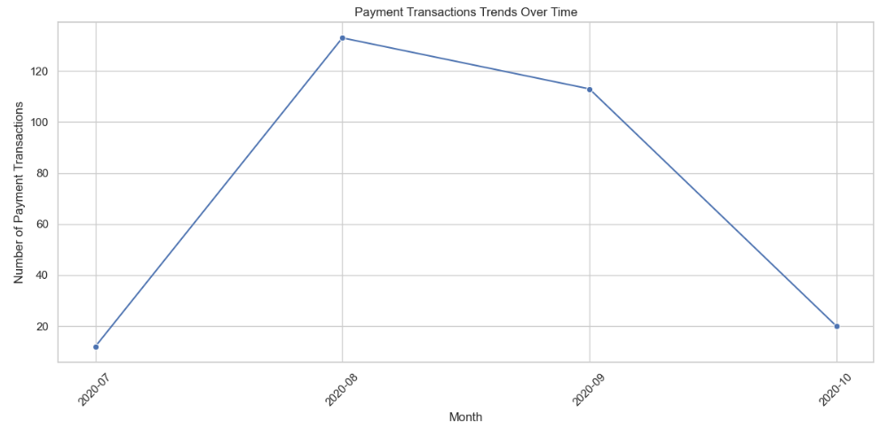
Analysis and Insight
Payment Trend Analysis
The trend reached its peak in August, marking the highest number of payment transactions in the period shown
There was a sharp decline in the number of payment transactions from September to October. This sharp decline may also indicate a change in payment behavior due to seasonal factors or policy changes

Slide 21
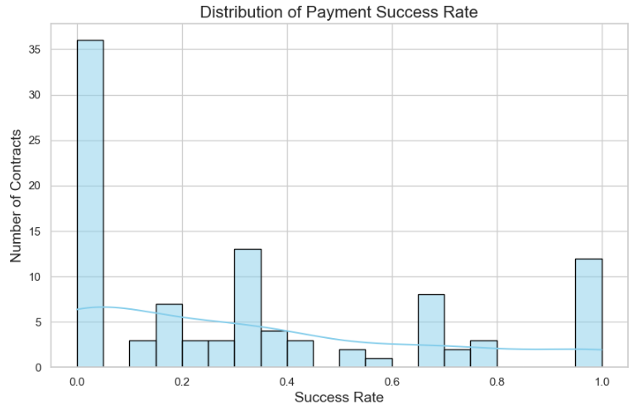
Analysis and Insight
Payment Success Rate Analysis
Many contracts have very low repayment rates, suggesting frequent payment failures or minimal repayments.
A prevalence of low repayment rates could signal cash flow issues or significant bad debts within the portfolio.
Some contracts have achieved a 100% repayment rate, indicating full payment fulfillment.

Slide 22


Thank You
You can check this notebook or Google Colab at the following link:
: https://bit.ly/recruitmenttest-fajrinovi-jn
: https://bit.ly/recruitmenttest-fajrinovi-gc

